Slide 1

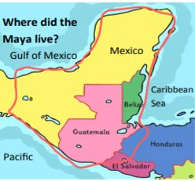
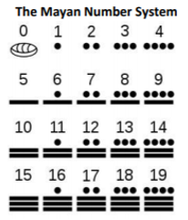
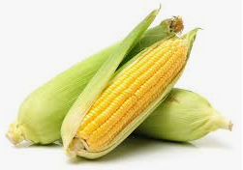
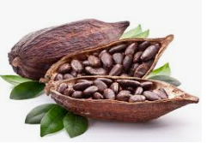
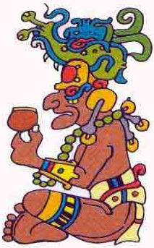
THE MAYAN CIVILISATION
KEY VOCABULARY
archaeologist | a person who digs up remains of old societies to find out about them
astronomy | the study of the sun, moon, stars, planets and other objects in space
base 20 | a number system based on multiples of 20 (rather than 10 like we use)
calendar | a system for organising days, weeks, months, years and longer divisions of time
civilisation | a complex organisation of human society
codex/codices | a Mayan book
conquistadors | knights, soldiers and explorers of the Spanish and Portuguese Empires
creation myth | a story explaining beliefs about how the world was created
hieroglyphs | writing made up of pictures and symbols
irrigation | the supply of water to land or crops to help growth
monarchy | a country or state ruled by a king or queen
rainforest | forests, found in tropical areas, with high temperatures and lots of rain
sacrifice | an offering to keep the gods happy
society | a group of people living together as an organised community
stela/stelae | stones or wooden posts which have writing on them
Year 6
Spring
2019/20
maize
cacao beans
900 BC
Farmers begin to use irrigation systems
292 BC
First evidence of Mayan writing
300 AD
Adoption of idea of monarchy
2000 BC
First evidence of
Mayan Civilisation
300 BC
First cities begin to develop
250 AD
Most powerful Mayan era begins
900 AD
Collapse of Mayan Civilisation
1500 AD
Arrival of Spanish
conquistadors
2000 BC
1000 BC
0
1000 AD
2000 AD
Itzamna – Creator god

